Slide 1

Project Work
Batch No: 4
Project Title: E-Commerce
S.No | PIN-NO | Student Name
1 | 22243-CM-016 | G. Praveen
2 | 22243-CM-026 | K. Tulasi
3 | 22243-CM-027 | K. Yamini
4 | 22243-CM-045 | R. Satya
5 | 22243-CM-052 | Sk. Siraaj
Project Guide:
M. Sai Durga Lakshmi

Slide 2
CONTENTS
Abstract
Introduction
Literature Survey
Problems in Existing System
Proposed System
Advantages of proposed system
Requirement analysis
- Functional Requirements
- Non-Functional Requirements
- Software Requirements
- Hardware Requirements
System Architecture
Design and Code
Implementation
Result Analysis
Conclusion

Slide 3
Abstract:
E-commerce(electronic commerce) is the buying and selling of goods and services, or the transmitting of funds or data, over an electronic network, primarily the internet. Customers use their own devices to access online stores. They can browse products and services those stores offer and place orders.
E-commerce is a cutting-edge online platform dedicated to providing a seamless shopping experience for a diverse range of products. Catering to a global audience, the website offers a curated selection options of spanning fashion like, shoes, backpacks, track suits and more.

Slide 4
Introduction
Definition:-
E-commerce or electronic commerce , refer to the buying and selling of goods and services over the internet , encompassing a wide range of online transactions that facilitate commercial activities without the need for physical storefronts.
Key components:-
The e-commerce ecosystem include various elements such as online retail platform , payment gateways , digital marketing strategies and customer service system , all working together to create a seamless shopping experience for consumers.
Market growth:-
The e-commerce sector has experienced exponential growth in recent years , driven by advancements in technology , increased internet accessibility and changing consumer behaviors , making it a vital component of the global economy.

Slide 5
Literature survey
The Role of e-Commerce:
In This the Survey was taken by the 28 literature Survey
According to this Survey Many of the people are interested to buy the Products from there Home and The would like to enjoy the shopping.
Many of the Shop Retails are also get there products sold out and get good recognized in the society

Slide 6
Type of E-commerce
Business to business
Business to consumer
Business to government
Consumer to consumer
Consumer to business
Consumer to government

Slide 7
Problems in Existing System
1.Techinical issues:
Slow website speed
2.User experience issues:-
Confusing the navigation
Insufficient product information
Poor customer service

Slide 8
Proposed system
1 . To reduce technical issues we use:-
Optimize images
Compress images
Use appropriate formats
Lazy loading
Minify CSS and JavaScript :-
Reduce file size
Combine files
Use CDN
2 . For user interface issues :-
Improve navigation
Provide detailed product information
Prioritize customer support

Slide 9
Advantages of proposed system
User can easily navigate to the different pages.
For giving the detail product information . We will use high quality images , videos and informative descriptions.
We will giving the main priority for the customers since they are the main reason for gaining the profit.

Slide 10
Requirement analysis
1.Functional Requirements:
Product Details
Promotions and Discounts
Customer Care and Support
Social Media Integration
2. Non-Functional Requirements:
Performance
Usability
Maintainability
Security

Slide 11
Software Requirements
Front end Development
Java Script
HTML, CSS.
Back End Development
Web Server
Programming language like PHP

Slide 12
HardWare Requirements
1.Server:
Processor: A multi-core processor with at least 2 cores is recommended for handling multiple requests simultaneously.
RAM: At least 4GB of RAM is necessary for efficient operation.
Storage: A solid-state drive (SSD) is preferable for faster data access and improved website performance. Consider starting with a minimum of 128GB of storage.
2.Network:
Internet connection: A reliable broadband connection with a minimum upload and download speed of 10 Mbps is recommended

Slide 13
Apps Used
Canva For Editing
VS Code For Coding
Pinterest For Information Gathering
Google For Literature Survey
Xmpp For Data Base Operations

Slide 14
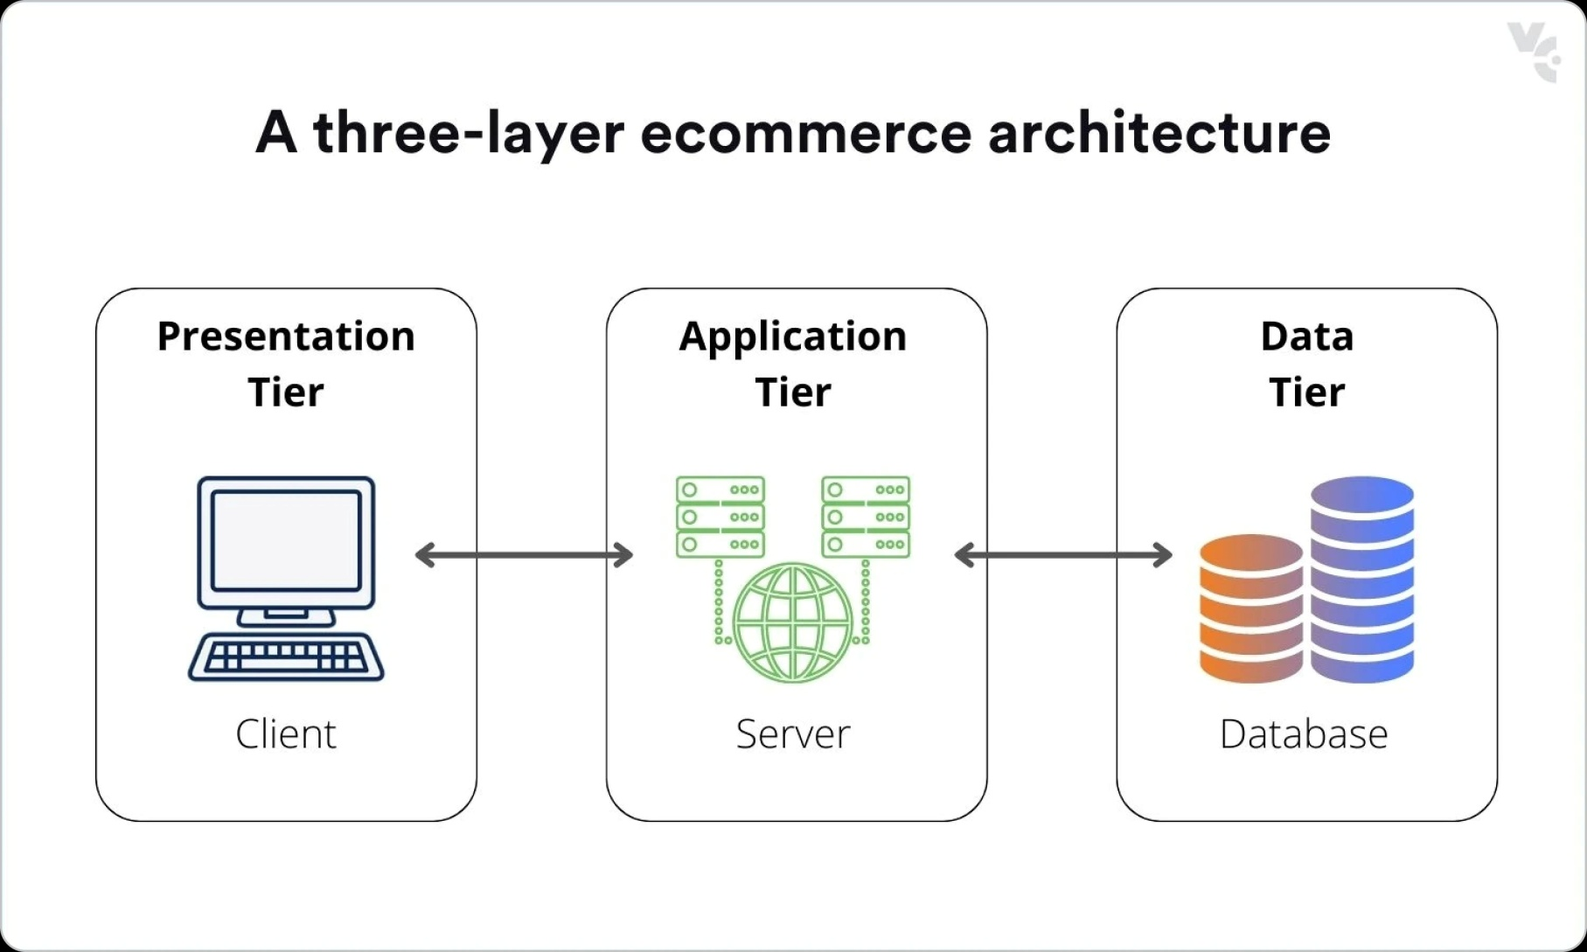
System Architecture

Slide 15


Design
login
Order
Cancel
View
Verification
Admin
Database
Customer

Slide 16
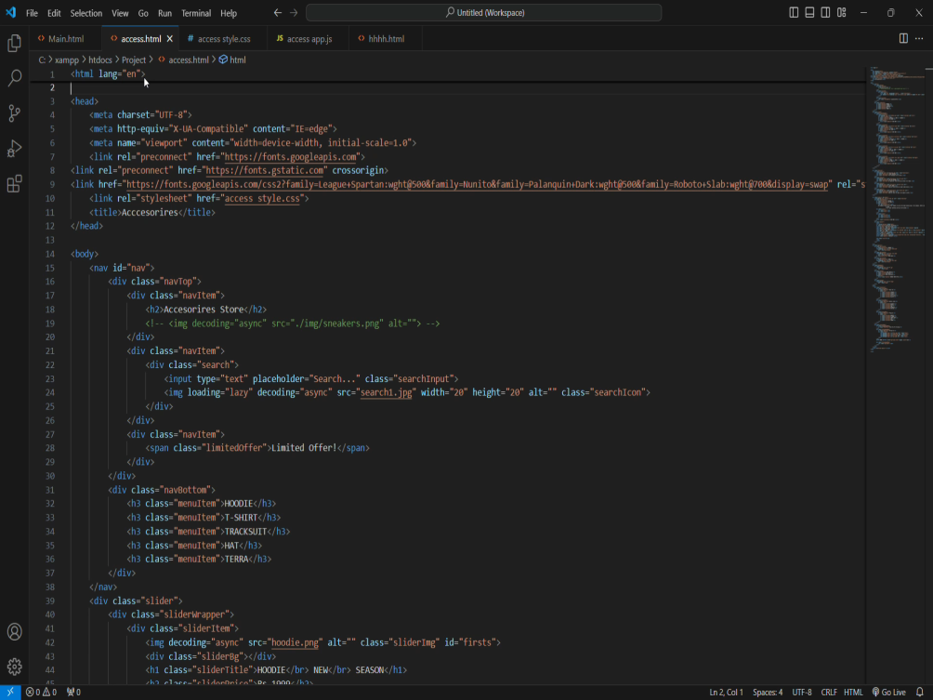
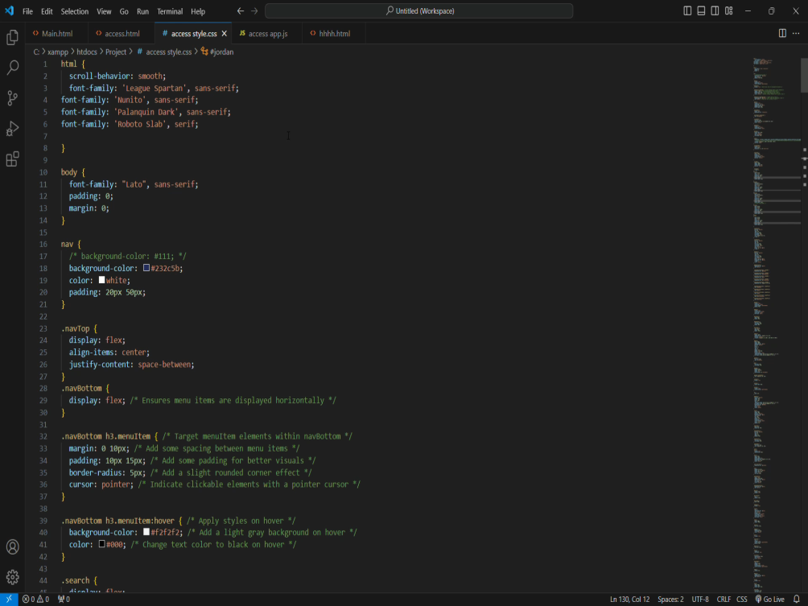
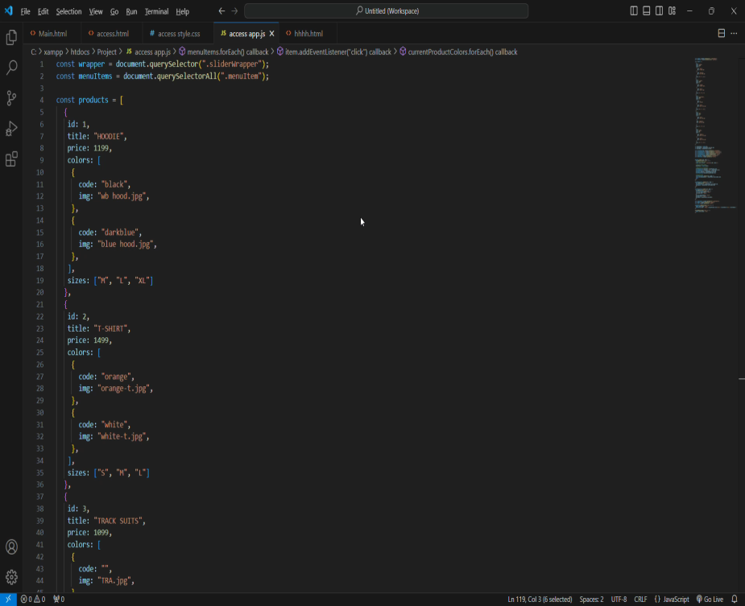
Coding:
HTML CODE:
CSS CODE:
JS CODE:

Slide 17
Implementation
Planning
Developing
Testing
Deployment
Maintenance And Updates

Slide 18
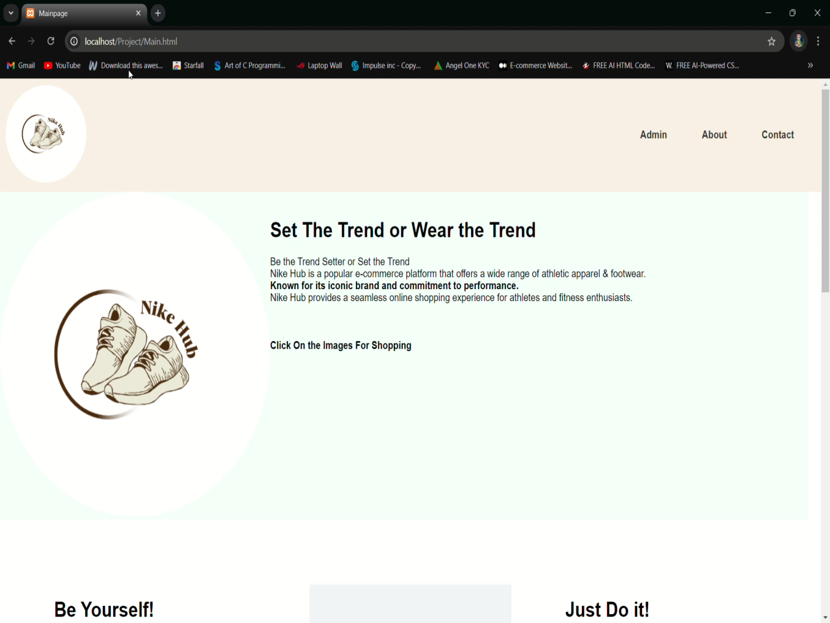
Result:

Slide 19
Conclusion
Our Website Provides Seamless Engaging Shopping Experience.
Through our Website Makes the Shopping More easier and Comfortable to Customers.

Slide 20
Thank you
Any Quires You Can Contact Us:-
1.praveensaikirshna016@gmail.com
2.Tulasisatyasri026@gmail.com
3.Yaminikollaparthi027@gmail.com
4.Sathyravipati045@gmail.com
5. shaiksiraaj052@gmail.com

